Slide 1
BANK APPlication
Presented By
KAVIYAPRIYA
MANAVI
PRAJNA
PAVITRA
SUJANA S R
Batch – 86
Group – 04

Slide 2
CONTENTS
INTRODUCTION
PRODUCT CATEGORIES
OTHER HIGHLIGHTS
OBJECTIVE
PROBLEM HANDLING

Slide 3
INTRODUCTION
BankApp is a banking application where several users wants some account info and some loan related info in the form of website
Banking is defined as the business activity of accepting and safeguarding money owned by other individuals and entities, and then lending out this money in order to conduct economic activities such as making profit or simply covering operating expenses.

Slide 4
PRODUCT CATEGORIES
Bank App deals with 3 product categories
1. CAR LOAN
-Rate of interest 5%.
-Average of Account holders will approach for car loan(~15).

Slide 5
2. EDUCATION LOAN
-Rate of interest 6%.
-Average of Account holders will approach for education loan(~65).
3. GOLD LOAN
-Rate of interest 4%.
-Less number of Account holders will approach for gold loan(~15)..

Slide 6
Objective
To retain the customer of BankApp by helping implement the strategy leveraging the current implementation and enhancing it wherever required and increase profitability.

Slide 7
PROBLEM HANDLING
Problem Handling processes are responsible for receiving trouble reports from customers, resolving them to the customer's satisfaction and providing meaningful status on repair activity to the customer. They are also responsible for customer contact and support in relation to any service-affecting problems detected by the resources or through analysis, including proactively informing the customer and resolving these specific problems to the customer's satisfaction

Slide 8
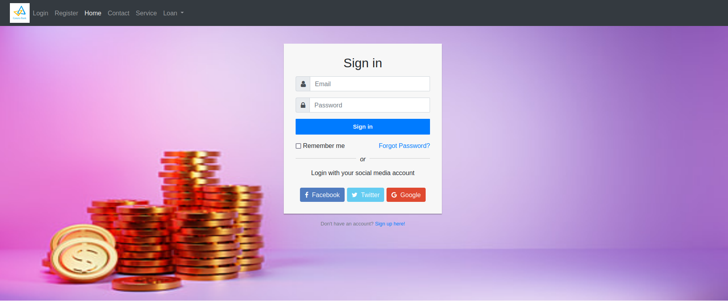

RESULTS

Slide 9
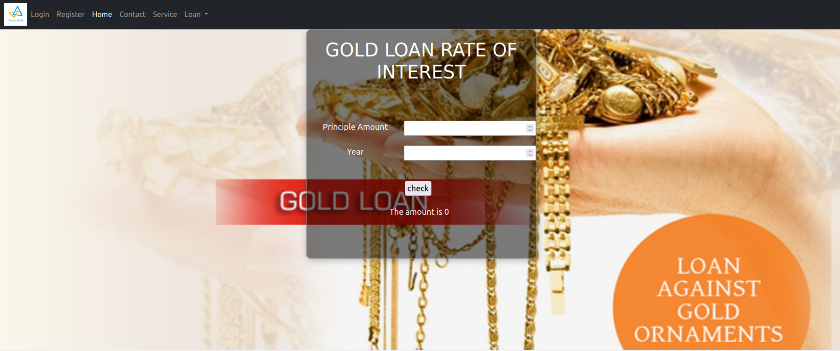

RESULTS

Slide 10
THANK YOU

